Slide 1
Architectural Design
Analogy: Architectural design is like creating the blueprint for a building, but instead of walls and rooms, we design the framework for software. It shows how different parts of the software will work together.
Definition: Architectural design is the process of planning how the software's main parts (hardware and software) will connect and work with each other to make the system functional.

Slide 2
Architectural Design..
Example:
Imagine we're building a food delivery app like pathao or foodmandu. The app needs several components to work together:
A User Interface for customers to browse restaurants and place orders.
A Backend System to process orders and manage data.
A Database to store information about restaurants, orders, and customers.
The architectural design decides:
How the user interface talks to the backend system.
How the backend system accesses the database.
How these components interact efficiently and securely.

Slide 3
Architectural Design Patterns/Types: Layered Architecture
Concept: The system is divided into layers, where each layer has a specific responsibility. Layers interact only with the layer directly above or below them.
Structure:
Presentation Layer: Handles user interfaces (e.g., websites or mobile apps).
Business Logic Layer: Processes application rules (e.g., validating a user’s login).
Data Access Layer/Persistence Layer: : Manages database operations and making sure the data remains available for future use, regardless of whether the application is running or not.
Database Layer: Stores the actual data.

Slide 4
Architectural Design Patterns/Types: Layered Architecture..
Example: An e-commerce website
Presentation Layer: The website you see (product pages, cart, etc.).
Business Logic Layer: Processes your order and calculates totals.
Data Access Layer: Communicates with the database to get product info, and handles the actual saving of this order into the database.
Database Layer: Stores product details, user accounts, and orders.

Slide 5
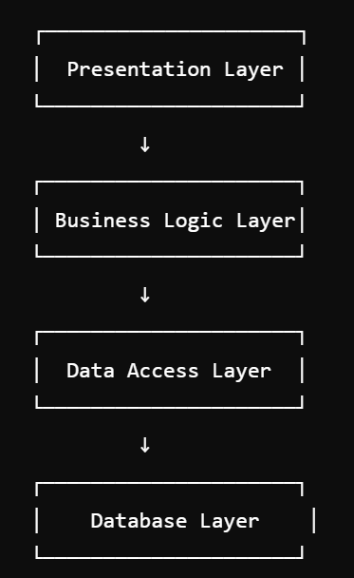
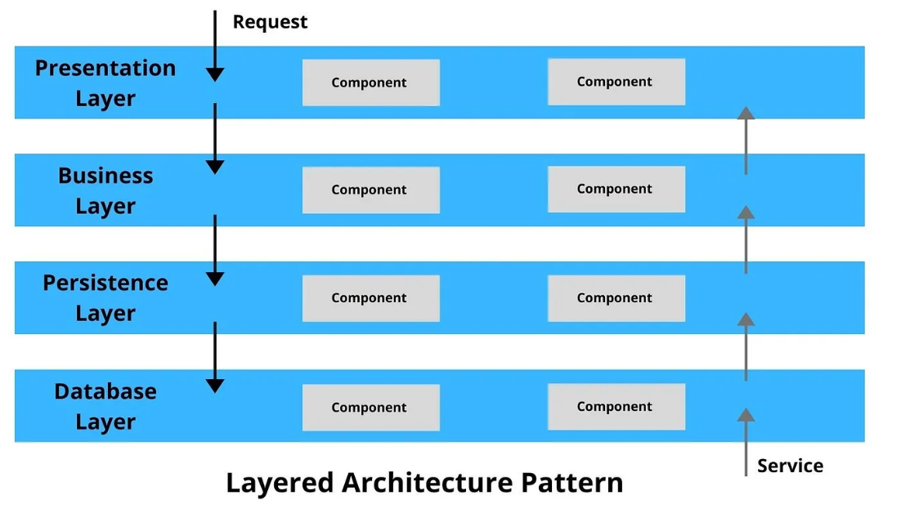
Architectural Design Patterns/Types: Layered Architecture..

Slide 6
Architectural Design Patterns/Types: Repository Architecture
Concept: A centralized data repository is used by various components of the system. All data is stored in one place, and different parts of the system read from or write to this shared repository.
Features:
Simplifies data sharing.
Ensures consistency of data.
Example: A version control system like Git:
Developers save their code in a central repository (like GitHub).
The repository manages changes and allows others to access or contribute to the same data.

Slide 7
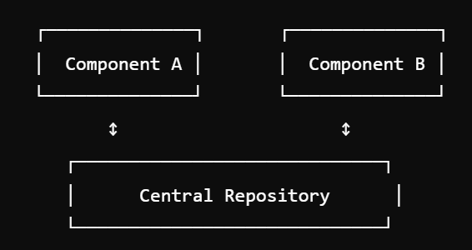
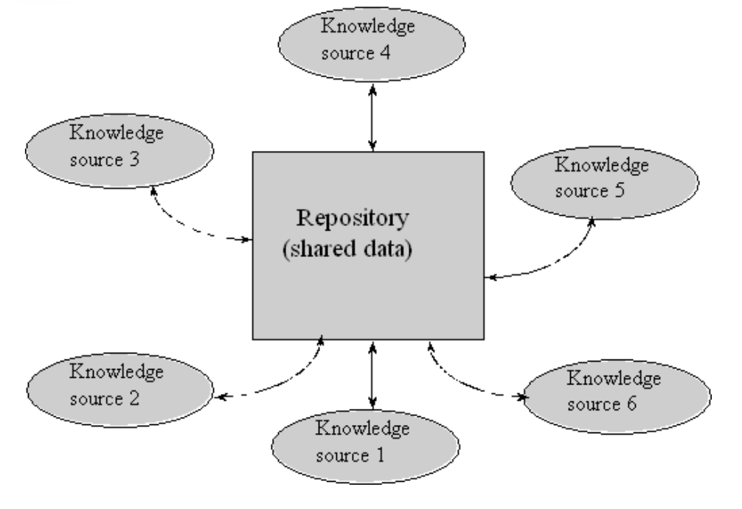
Architectural Design Patterns/Types: Repository Architecture..

Slide 8
Architectural Design Patterns/Types: Client-Server Architecture
Concept: The system is divided into two parts:
Client: Requests services.
Server: Provides services. Clients and servers communicate over a network.
Features:
Centralized control of data and services.
Multiple clients can connect to a single server.
Example: A banking application:
Client: The banking app on your phone (sends requests like checking your account balance).
Server: The bank’s server processes your request and sends back the data.

Slide 9
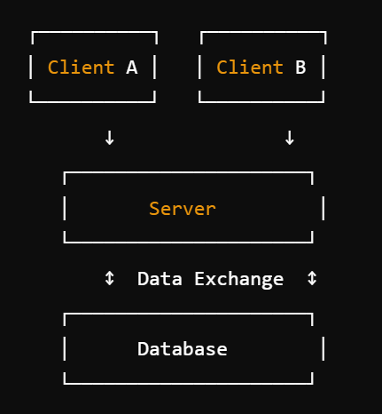
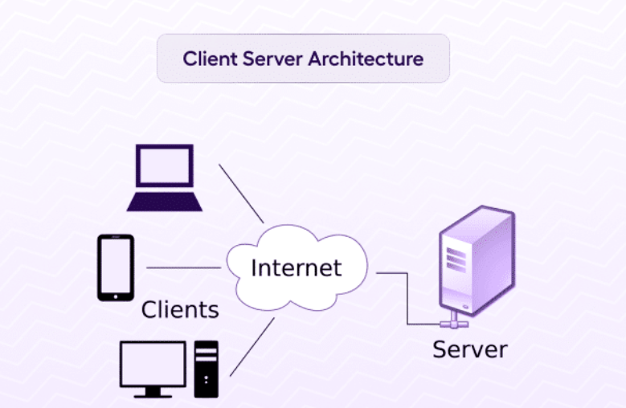
Architectural Design Patterns/Types: Client-Server Architecture..

Slide 10
Architectural Design Patterns/Types: Pipe and Filter Architecture
Concept:
The system is divided into components called filters that process data. These filters are connected by pipes, which transport the data from one filter to the next.
Features:
Filters perform specific transformations (e.g., cleaning, processing, or formatting data).
Pipes carry data between filters.
Each filter is independent, making the system flexible and reusable.
Example:
A compiler:
Input: Source code.
Filter 1: Lexical analysis (converts source code into tokens).
Filter 2: Syntax analysis (checks for errors).
Filter 3: Code generation (converts to machine code).
Output: Executable file.

Slide 11
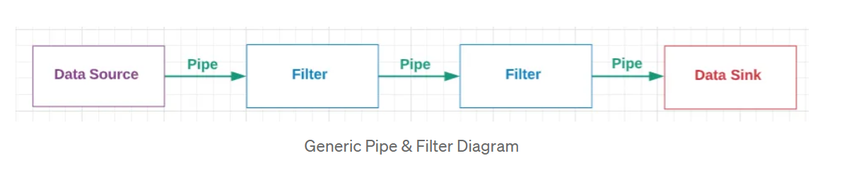
Architectural Design Patterns/Types: Pipe and Filter Architecture..
There are four main components:
Data Source: The original, unprocessed data
Data Sink: The final processed data
Filter: Components that perform processing
Pipe: Components that pass data from a data source to a filter, or from a filter to another filter, or from a filter to a data sink

Slide 12
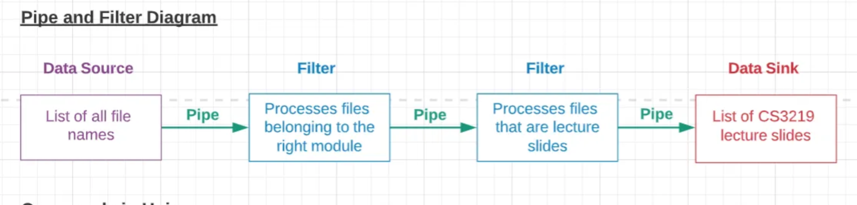
Architectural Design Patterns/Types: Pipe and Filter Architecture
Input → [ Filter 1 ] → [ Filter 2 ] → [ Filter 3 ] → Output

